Slide 1
Cat vs Dog
CNN image classification project — ITAI 1378 final

Slide 2

Introduction
A CNN-based image classifier built to distinguish cats from dogs using the TensorFlow Cats vs Dogs dataset.
The project demonstrates the full ML pipeline: data preparation, model design, training, and evaluation, delivered as a concise proof of concept.

Slide 3
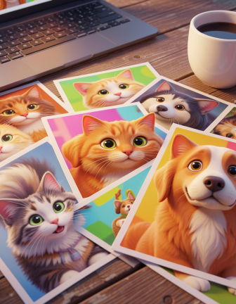
01
Problem & Dataset

Slide 4

Problem statement
Manual image classification is slow and error-prone.
Goal: Build an automated system to classify images as Cat or Dog with reliable accuracy on clear images.

Slide 5
Dataset summary
Dataset: TensorFlow Cats vs Dogs (~23,000 images).
Images were resized and normalized; data split into training and validation sets. Preprocessing ensures consistent input for the CNN.

Slide 6
Project goals
Automate binary image classification to distinguish Cat vs Dog using a CNN.
Deliver a working proof-of-concept demonstrating the full ML pipeline: data ingestion, preprocessing, model training, and prediction. Emphasize reproducibility and clarity for future improvements.

Slide 7

02
Model & Results

Slide 8
CNN architecture
Stacked Conv2D layers for feature extraction, MaxPooling for spatial reduction, and Dense layers for decision-making.
Sigmoid output for binary probability. Implemented in TensorFlow/Keras for rapid prototyping and deployment.

Slide 9

Training process
Data split into training and validation sets; images resized and normalized.
Training run for 2 epochs (time-constrained) using Adam optimizer and binary crossentropy loss. Visualize training accuracy and loss for monitoring.

Slide 10
Evaluation & Improvements
Model correctly classifies most clear images; failures occur on blurry or ambiguous inputs.
Planned improvements: increase epochs, apply data augmentation, and adopt transfer learning (e.g., ResNet or MobileNet) to boost robustness.

Slide 11
Conclusions
Built a functional CNN classifier that performs well on clear samples and illustrates the end-to-end process.
Next steps focus on enhanced training, augmentation, and transfer learning to improve accuracy and real-world reliability.

